Slide 1



CARE
Hospital Management System Overview and Insights
Smart Hospitals: How Technology is Enhancing Patient Care

Slide 2

Meet the Team
Below are the key contributors to the CARE Project – Hospital Management System.
FATIMA NAHID – Team Leader: Oversees the overall project progression and coordinates the team.
JAVERIA – Team Member: Responsible for contributing to specific project tasks and supporting the team.
ABDUL GHANI – Team Member: Focuses on assisting with project development and implementation.
HUZAIFA FAHIM – Team Member: Ensures the project meets quality standards and contributes to testing.
ASHAR HUSSAIN – Team Member: Analyzes requirements and helps align project objectives with the team’s goals.
2

Slide 3



System Overview
Transforming Hospital Management for Enhanced Efficiency and Patient Care
The CARE Project aims to streamline hospital operations through an innovative management system.
By providing a digital solution for scheduling, record-keeping, and communication, this system enhances efficiency, reduces errors, and improves overall patient care in healthcare facilities.
3

Slide 4
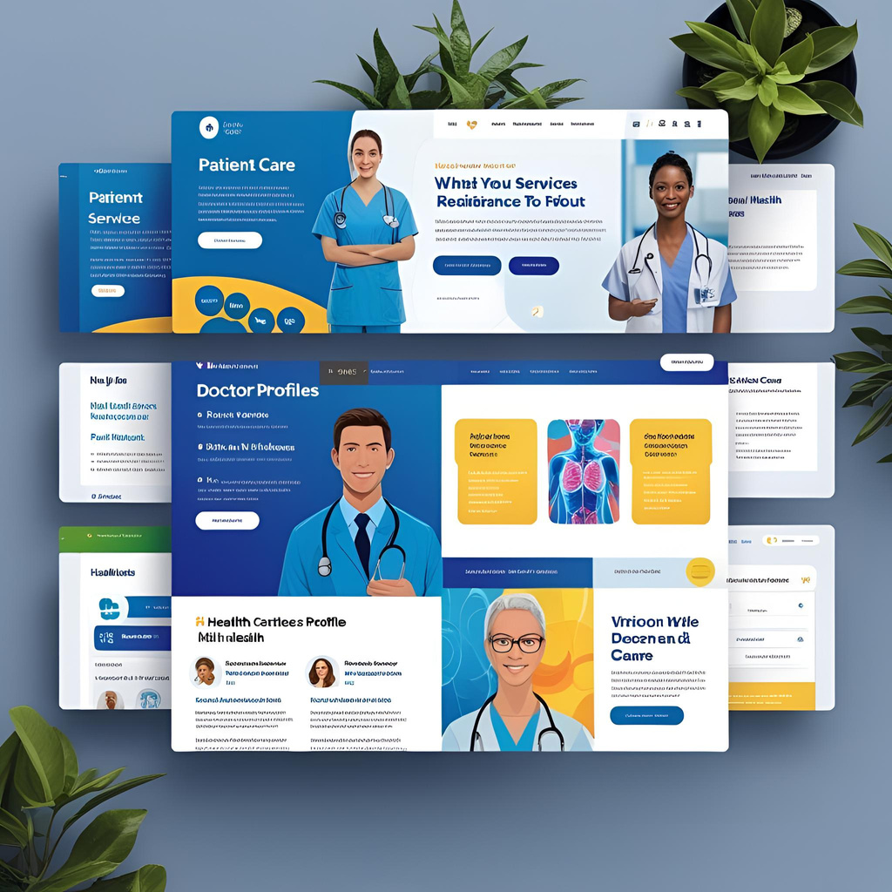
Workflow Challenges
Manual Processes in Healthcare: Inefficiencies and Risks
Manual workflows in healthcare lead to significant delays and errors in patient care.
These processes are often time-consuming and hinder communication, resulting in inefficient service delivery and increased risks for patient safety and satisfaction.
4

Slide 5
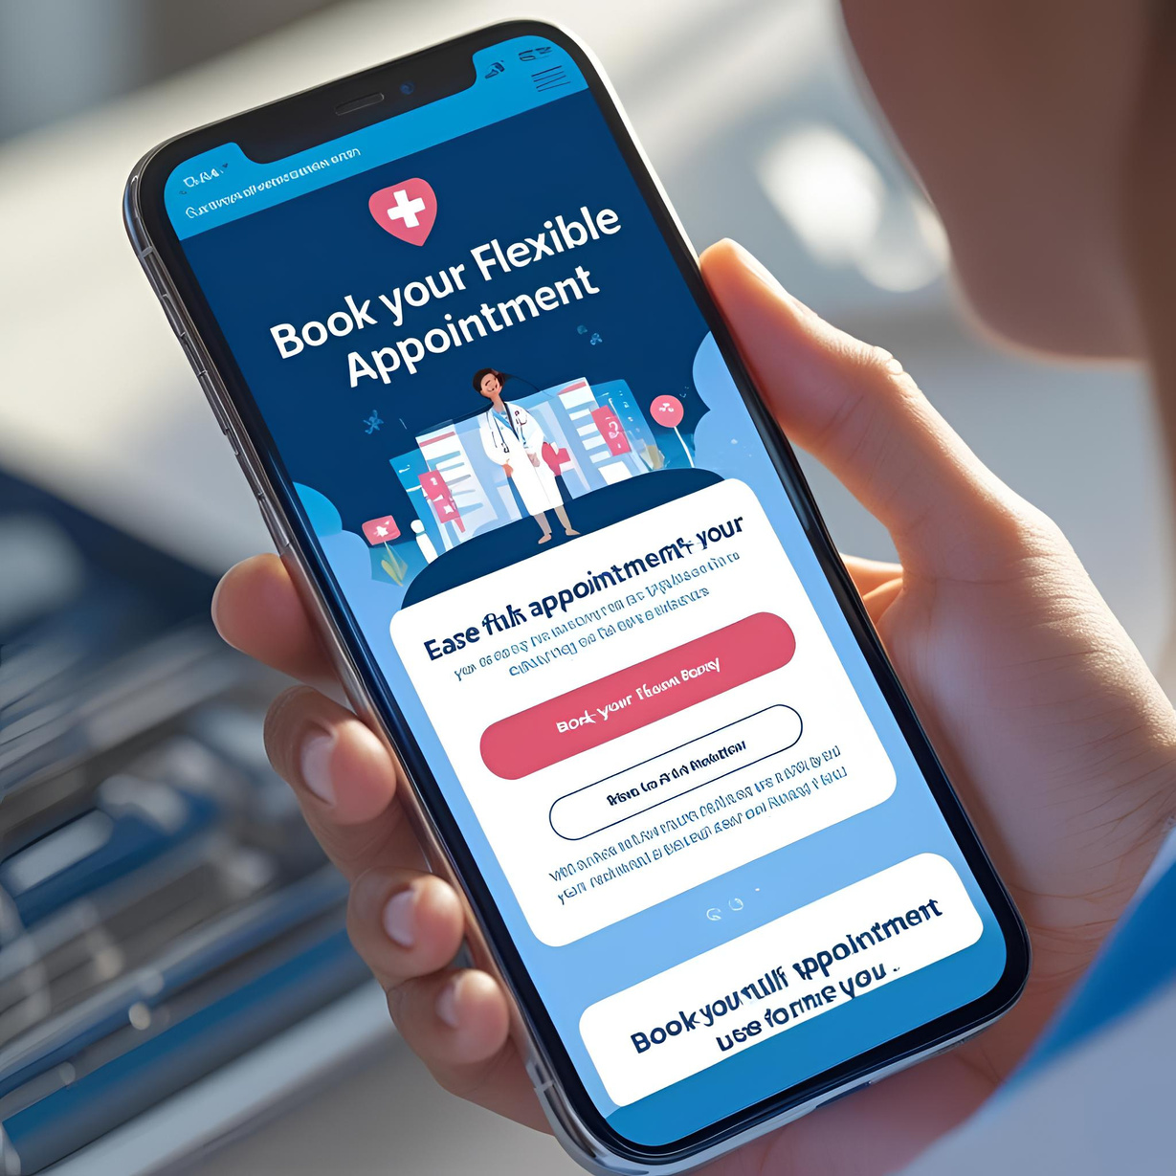
Our Goals
Embracing Digital Solutions for Enhanced Healthcare Management
Our project aims to provide flexible booking options that cater to patient needs.
By implementing user-friendly dashboards, we enable staff to monitor operations efficiently and make data-driven decisions, ultimately enhancing patient care and service delivery.
5

Slide 6


Role-Based Dashboards Overview
Admin features for efficient management and oversight
Doctor features for streamlined patient care and reporting
Patient features for easy access to health information
Admins can monitor system performance, manage users, and generate reports seamlessly.
Doctors can view patient histories, schedule appointments, and access clinical tools efficiently.
Patients can book appointments, view test results, and manage their health records online.
6

Slide 7
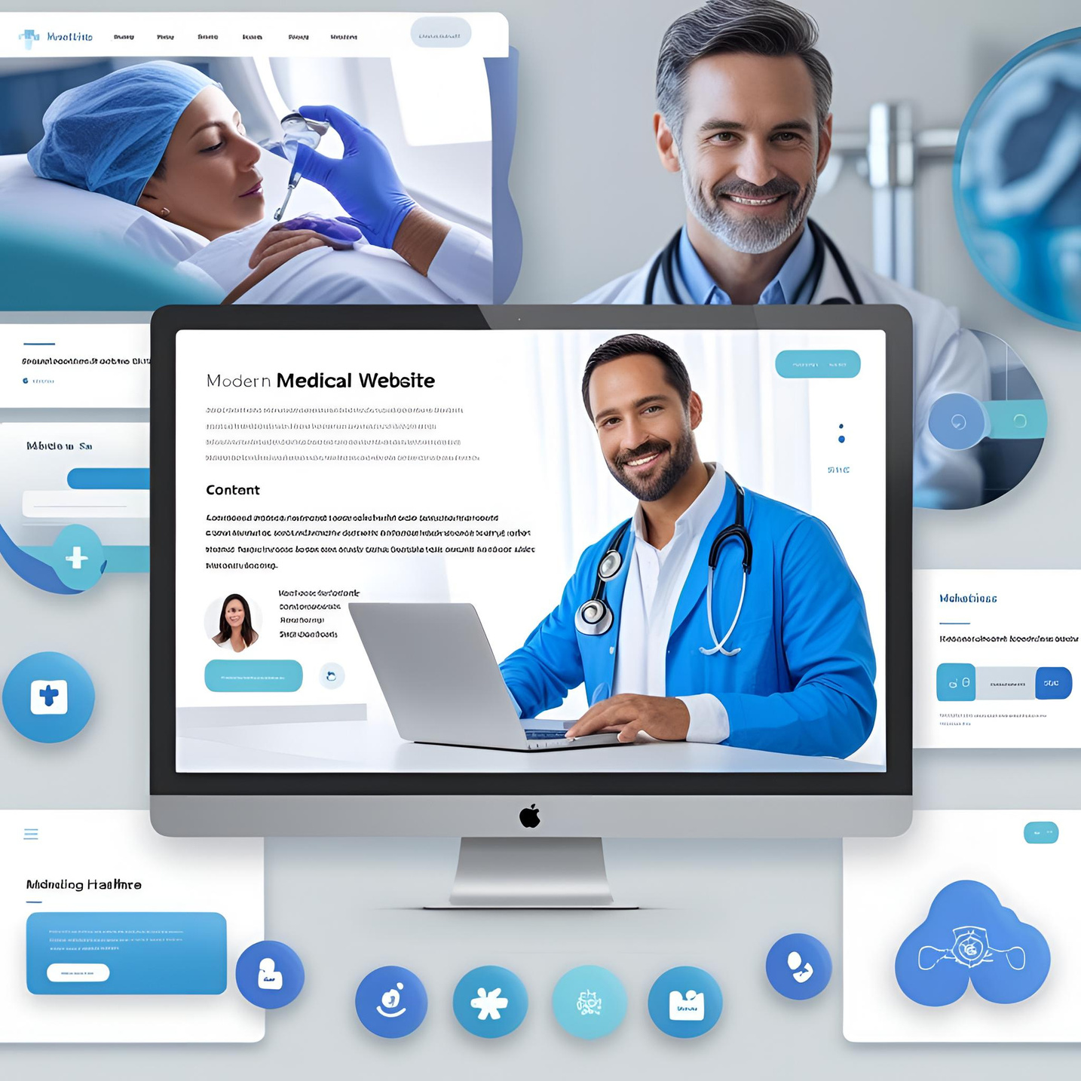
What Admins Can Do
Managing operations effectively to enhance hospital workflow and service delivery
Admins play a crucial role in streamlining processes within the hospital management system, enabling efficient scheduling, resource allocation, and data management to ensure optimal patient care and organizational efficiency.
7

Slide 8

Empowering Healthcare Professionals
Tools for Efficiency in Patient Care and Management
The Doctor Features module provides essential tools for effective patient management, allowing doctors to access records, schedule appointments, and communicate directly with patients, improving overall care and efficiency in the healthcare system.
8

Slide 9
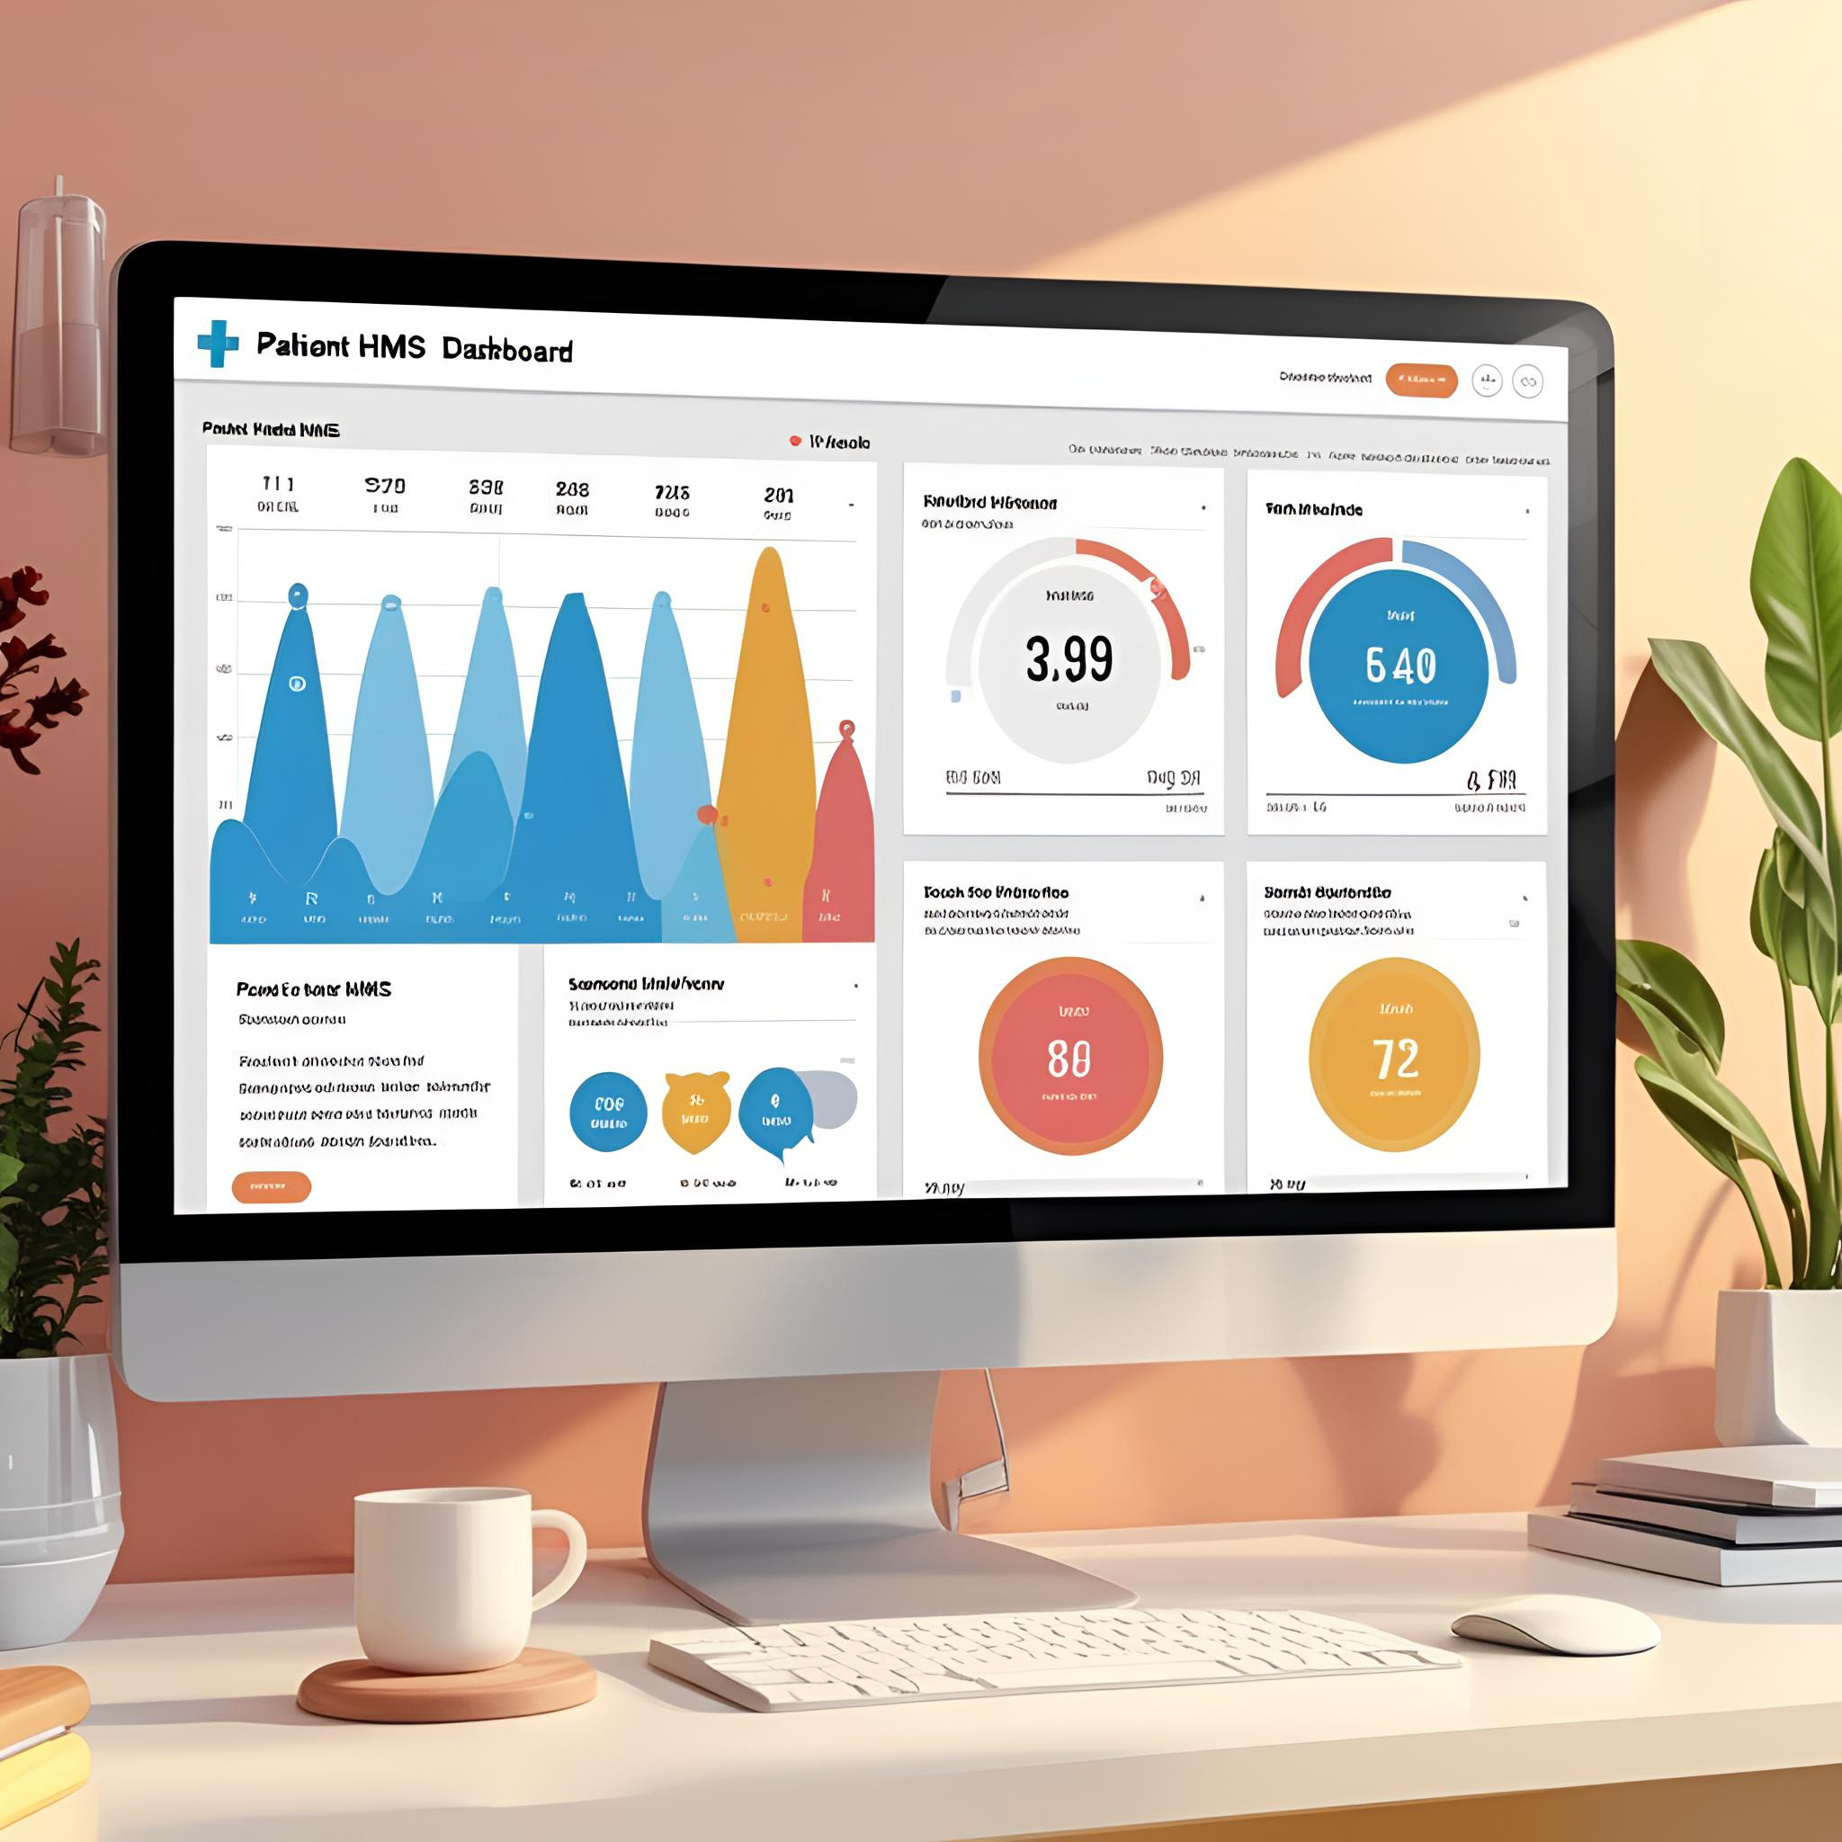
Patient-Centric Solutions
Enhancing user experience through tailored features for better healthcare access and communication
Our system provides patients with streamlined access to healthcare services, including flexible appointment scheduling, online consultation, and real-time updates on their medical records, ensuring a more efficient healthcare experience.
9

Slide 10
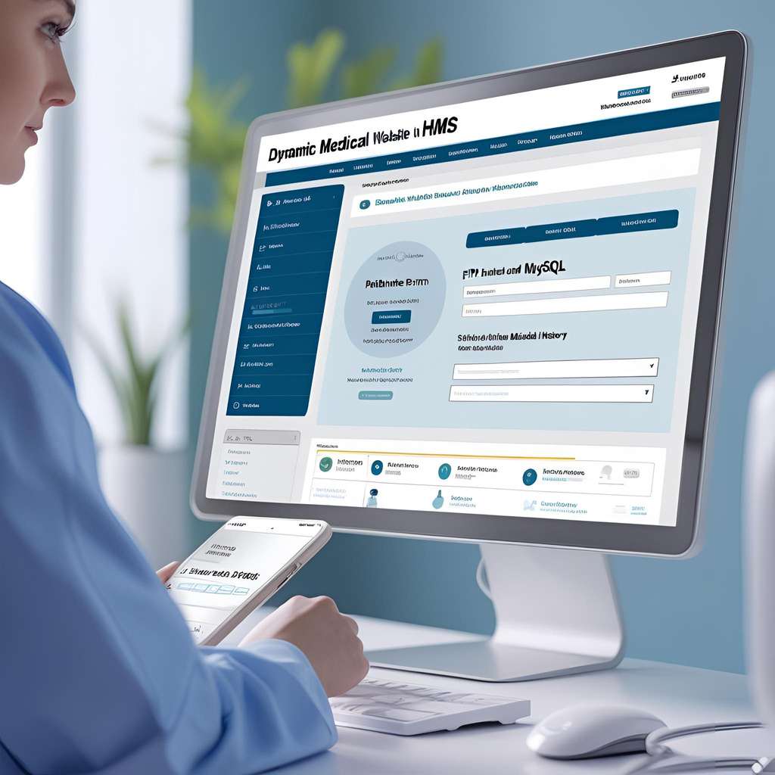
Our Tech Foundation: Building a robust hospital management system
Comprehensive Stack Overview
Our system utilizes the latest web technologies effectively.
The CARE Project employs HTML5, CSS3, JavaScript, and PHP to create an intuitive interface. Utilizing MySQL for database management ensures efficient data handling, while XAMPP provides a seamless development environment.
10

Slide 11
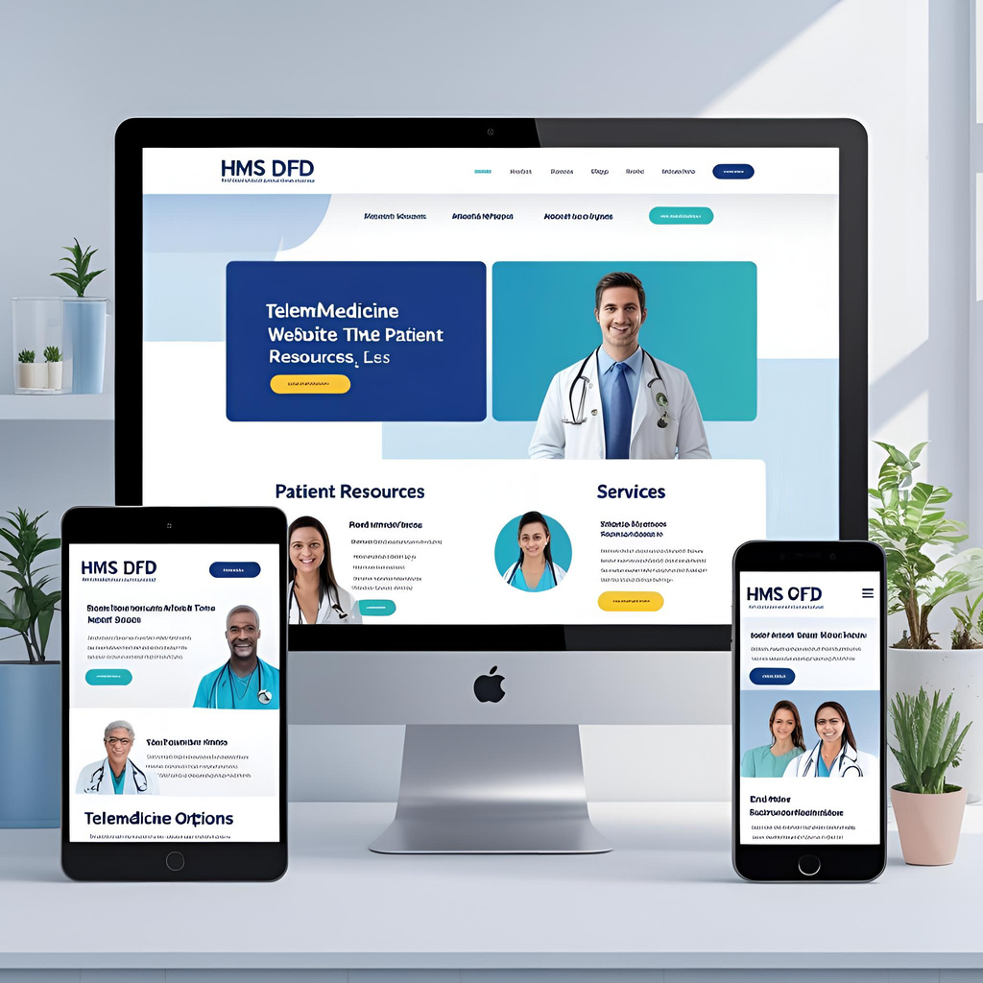
Visualizing Our Framework
Custom Data Flow Diagram (DFD) for the CARE Project Hospital Management System
This diagram illustrates the interconnected components of our hospital management system's architecture.
It highlights how data flows between various modules, ensuring efficiency and streamlined operations for admin, doctors, and patients, ultimately enhancing overall hospital management.
11

Slide 12
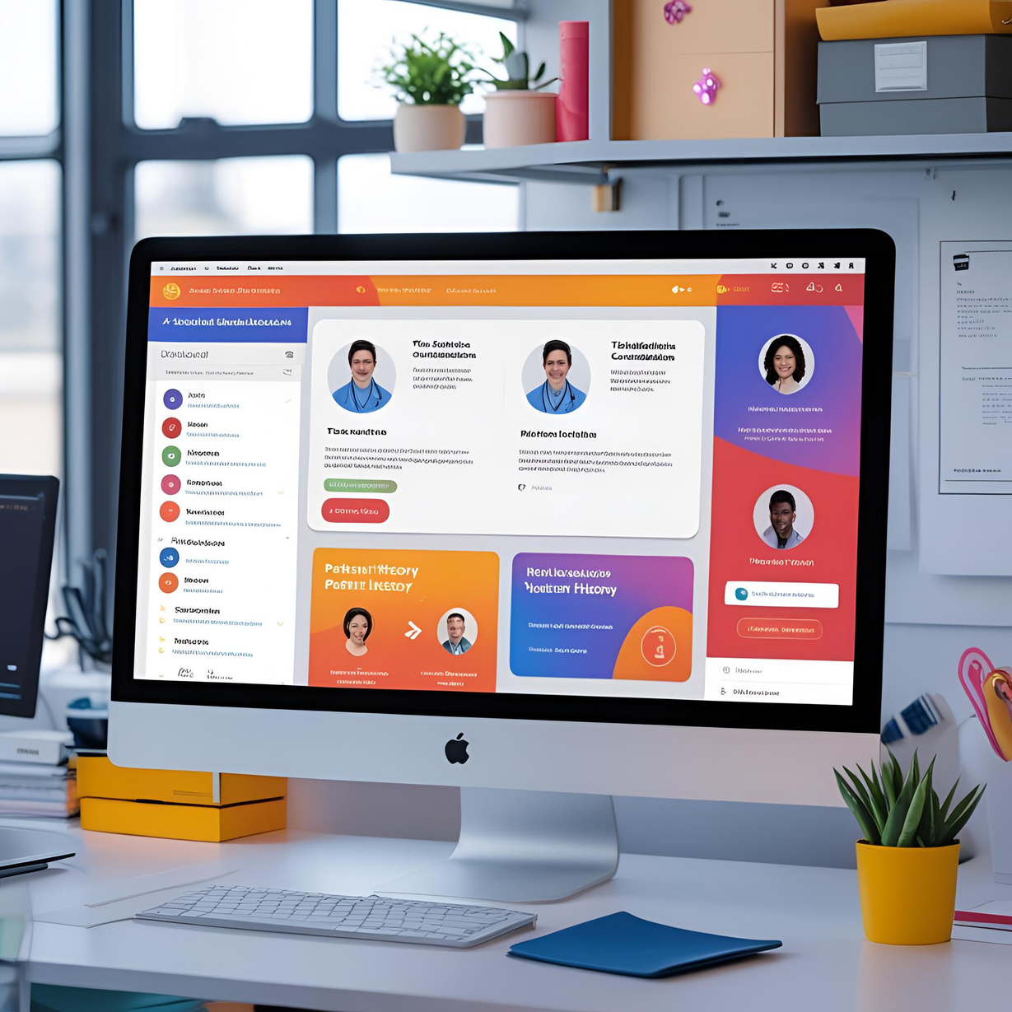
User Interface Design
A Glimpse of Our Hospital Management System User Interface
Our intuitive design focuses on user experience and accessibility.
Each UI element is crafted to ensure seamless navigation for all users, including doctors, admins, and patients. The layout enhances efficiency and usability while maintaining a professional aesthetic.
12

Slide 13
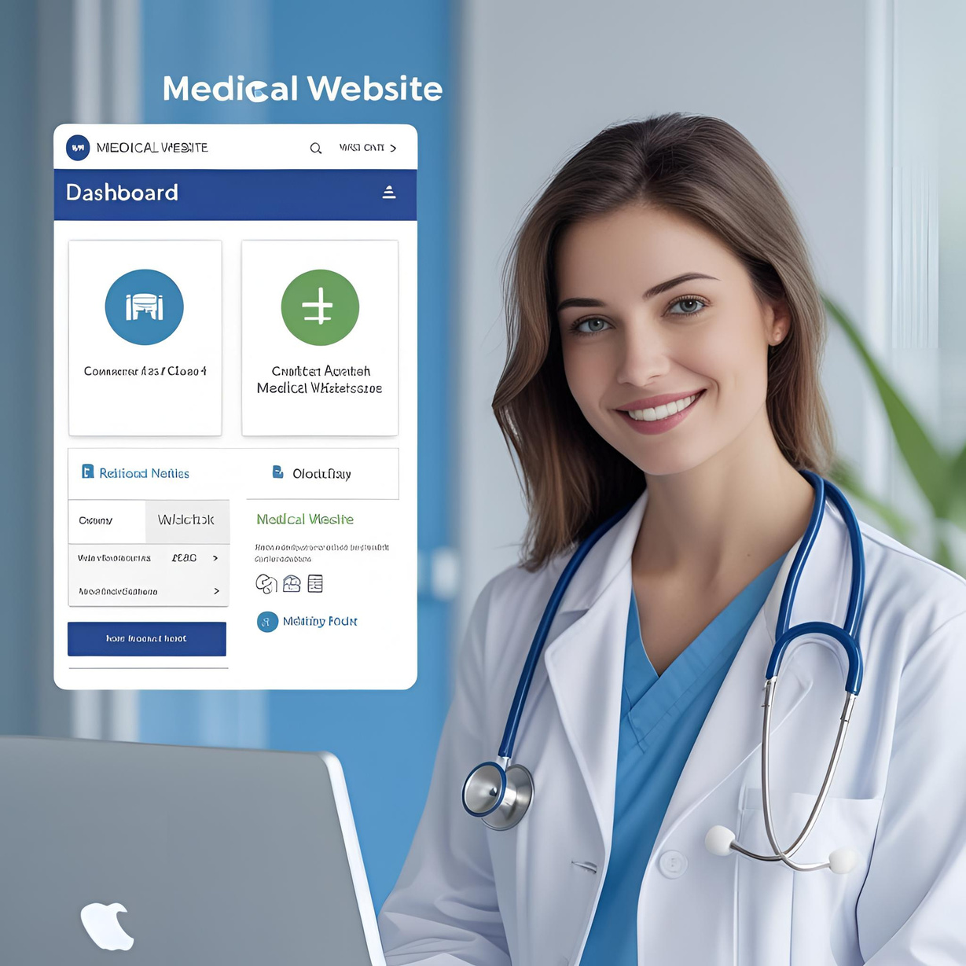
Overcoming Hurdles
Navigating Obstacles in the CARE Project Development Process
During the development of the CARE Project, we faced significant challenges that tested our team's resilience.
These challenges included managing time constraints, ensuring effective communication, and integrating complex systems. Our commitment to finding innovative solutions helped us navigate these obstacles successfully.
13

Slide 14

Looking Ahead
Continuous Improvement and Growth for the CARE Project System
Future updates will focus on enhancing user experience and increasing system efficiency.
By integrating advanced analytics and providing more personalized features, we aim to ensure the CARE Project remains at the forefront of innovative hospital management solutions.
14

Slide 15


Key takeaway from the CARE Project Hospital Management System
95% patient satisfaction
High satisfaction rates indicate effective management solutions
This impressive 95% patient satisfaction rate demonstrates the improvements in service delivery and engagement achieved through the CARE Project, fostering a healthier environment for both patients and staff.
15

Slide 16
Thank you for your attention and questions
CARE HMS Project
Presented by Fatima Nahid & Team members (2407E1)
16

